Slide 1
TOSS Pilot Pilot for Framework Validation
(Planning Document)
Pindy Bhullar

Slide 2
Agenda
Introduction to the TOSS Project
Why do we need TOSS
Objectives
Identify Pilot Organisations
Engagement Model
Plan to Initiate Pilot
Requirements for the Research Study
Next Steps – April and Early May
Appendix – Pillars and Personas

Slide 3
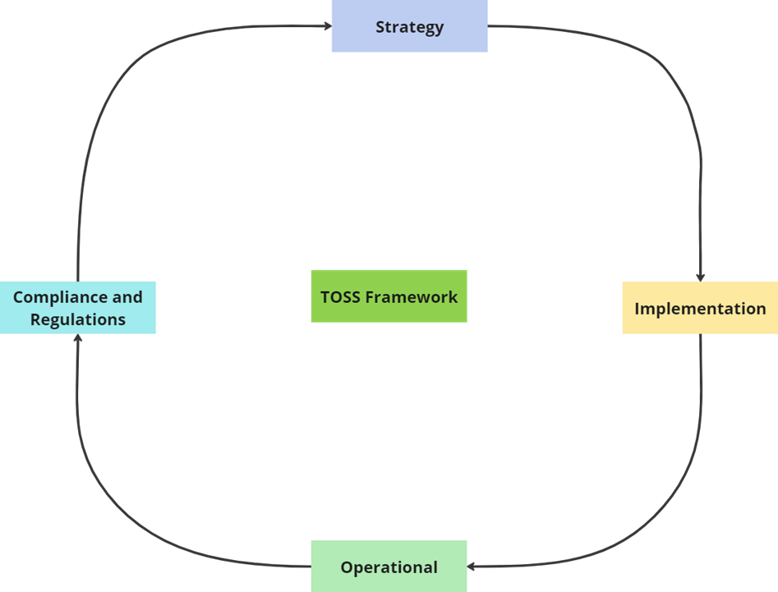
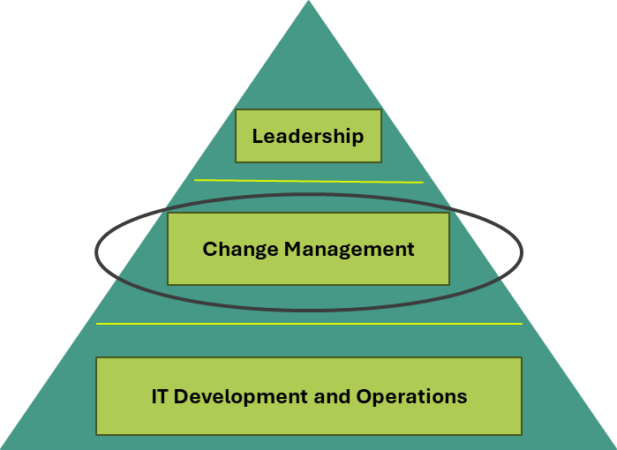
Introduction to the TOSS Project
TOSS – Transforming Organisations for Sustainable Software
Project under the Standards WG
Launched January 2024
Co-chairs Pindy Bhullar and Sean O’Keefe
Part of a PhD research study

Slide 4

Why do we need TOSS
Organisations are at various stages of implementing Green IT practices
We need a practical approach to enable organizations to embed Green Technology Culture, Tooling, and Knowledge (the Green Software Foundation Pillars)
The TOSS framework provides companies with an approach to build a future-proof foundation for continuous improvement and change management regarding the sustainable development and use of their software operations.
Rather than address green software practices on a case-by-case “point-solution” approach, the TOSS framework can allow for the organization-wide transformation to embed a company’s software practices with both cohesion and agility in matters of sustainability.

Slide 5
Objectives
The objectives of the pilot:
To evaluate the effectiveness, practicality, and usability of the TOSS framework in real-world organisational contexts.
Aims to identify strengths and pinpoint any areas requiring refinement, ensuring the framework's steps and documentation clearly meet stakeholders' needs.
Seeks to confirm the value the framework delivers to organisations, assess alignment with intended outcomes, and gather evidence to support broader adoption and scalability.
To run the pilot in 4 to 6 organisations (flexible how the TOSS framework can be applied)

Slide 6



Identify Pilot Organisations
To effectively identify suitable pilot organisations. The following criteria will be used:
Organisations currently planning or actively implementing measures to assess the carbon emissions associated with their software.
Organisations that have leadership support for innovation and change.
Organisations that are willing to trial the TOSS framework.
Organisations prepared to establish a dedicated team to pilot the TOSS framework.
Organisations that will dedicate a project champion(s) to facilitate smoother collaboration and richer feedback.
Organisations that are willing to be part of the research study.
Organisations that are willing to share the pilot feedback and data to the research study (all data and names of organisations and individuals will be anonymized.

Slide 7
Engagement Model
 | Organisation led | Organisation and Researcher co-led | Researcher led
Mode of operandi | Led by the pilot organisation | Co-led by a champion from the organisation Co-led by the researcher | Led by the researcher
Roles and responsibilities | Project champion(s) to oversee the Pilot Personas to trial the framework and provide feedback | Project champion(s) to oversee the pilot Researcher to oversee the pilot Personas to trial the framework and provide feedback | Researcher to oversee the pilot Point person from the organisation Personas to trial the framework and provide feedback
Requirements for pilot | Define what success looks like. Online or in person facilities to enable discussions and feedback sessions Access to TOSS online materials Researcher to sit in and observe pilot sessions Method to track progress Completion of pilot feedback forms | Define what success looks like. Online or in person facilities to enable discussions and feedback sessions Access to TOSS online materials Researcher to participate in regular pilot sessions Method to track progress Completion of pilot feedback forms | Define what success looks like. Online or in person facilities to enable discussions and feedback sessions Access to individual and teams Access to TOSS online materials Researcher to lead the sessions and provide feedback to organisation Method to track progress Completion of pilot feedback forms
Meeting schedule | Bi-weekly check-ins with project champion and researcher Ad-hoc sit in and observe pilot sessions | Co-leads to plan TOSS pilot sessions based on team/individuals' availability Bi-weekly project champion and researcher standups (can be done via email if diaries do not allow) | Researcher to plan TOSS pilot sessions based on team/individuals' availability Bi-weekly point person and researcher standups (can be done via email if diaries do not allow)

Slide 8
Plan to Initiate Pilot
The pilot will run from approx. 2nd June 2025 to 1st December 2025 (6-month duration)
Planning with pilot organisation(s) Meetings – 22nd April to 30th May
Maturity Matrix Assessment
Initiate Pilot
Gather continuous feedback
Summary session with pilot organisation(s) – 1st December to 19th December
Introductions
What is TOSS
What will the Pilot entail
Assess where the organisation fits into the Maturity Matrix
Plan the pilot based on the maturity assessment
Determine the key personas and teams that will participate in the pilot
Provide their responsibilities, the dedicated time to the pilot and what will be expected from them
Sign research ethics documentation
Initiate the pilot
Continuously gather feedback
Provide summary of pilot
Present next steps
Close the pilot
Researcher to share the research paper with participating organisations.

Slide 9

Requirements for the Research Study
Conducting a research study involving participating organisations, several ethics, consent, and regulatory requirements must be met to ensure the study is legal, ethical, and valid. Outlined below are the key research requirements for participating pilot organisations:
Ethics approval has been granted from the University of Southampton Research Ethics Committee.
Organisational consent. The consent forms will provide description of the study, roles and expectation of the organisation, agreement on pilot, anonymity processes to ensure all data, individual names and organization details are not shared.
Informed consent from individual participants:
Study purpose
What participation involves
Confidentiality measures
Right to withdraw
Contact information
GDPR – data processing and secure storage

Slide 10
Next steps – May and early June
High Priority
Pindy to create a presentation for organisations to share with teams and management to seek buy-in.
Medium Priority
Pindy to create the engagement model documentation (Introduction documentations, pilot feedback forms, pillar documentation etc.
Pindy and pilot organisation to create individuals and teams that will participate. Detailing the responsibilities, time taken, outcomes etc.
Pindy to create pilot documentation that will be used over the 6-month period (The purpose, pillar documentation, Q/A, etc).
Pindy to create the research organisation and individual consent forms and participation information sheet, data capture and storage.

Slide 11
Appendix

Slide 12
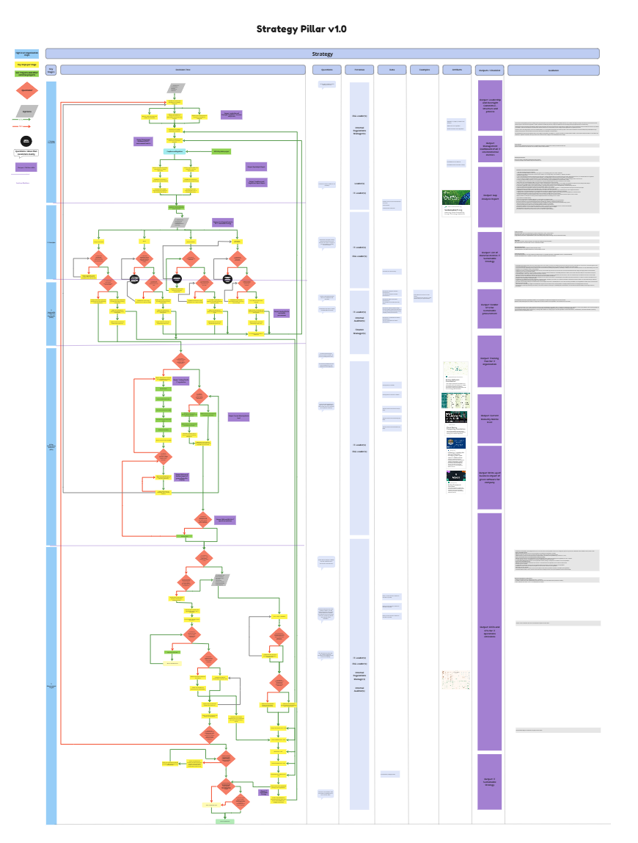
Strategy Pillar and Personas
Persona | RACI | Key Motivation | Artifacts | Data Required
Leader | Responsible | As a leader, I am driving the strategic vision and overall growth of the organization with a commitment to sustainable IT practices. | Strategic sustainability plans, executive sustainability reports, green performance dashboards. | Market analysis and trends, Performance metrics and KPIs, Financial reports and forecasts, Competitor analysis, Stakeholder feedback
ESG Leader | Accountable | As an ESG leader, I am ensuring that our company meets and exceeds environmental, social, and governance standards, particularly in IT. | ESG reports, IT sustainability assessments, compliance certifications for green IT. | Regulatory requirements and guidelines, Sustainability performance metrics, Environmental impact data, Stakeholder expectations and feedback, Benchmarking data against industry standards
Internal Regulations Manager | Consult | As an internal regulations manager, I am establishing and enforcing policies to ensure organizational compliance with sustainable IT practices. | Green policy documents, IT sustainability compliance checklists, internal green audits. | Regulatory and compliance requirements, Internal audit findings, Compliance metrics and reports, Industry best practices, Policy and procedure documentation
Finance Manager | Informed | As a finance manager, I am overseeing the financial health and reporting of the organization, including investments in sustainable IT. | Financials - profit and loss, balance sheet, cash flows. Finance impacted sustainability reports. | Financial performance metrics, Budget and expenditure data, Investment opportunity assessments, Cost-benefit analysis of green initiatives, Financial forecasts
Internal Auditor | Consult | As an internal auditor, I am evaluating the effectiveness of our internal controls and risk management processes with a focus on sustainable IT. | Green audit reports, IT sustainability risk assessments, compliance reviews. | Audit criteria and standards, Risk assessment data, Compliance documentation, Historical audit reports, Process and control documentation
IT Leader | Accountable | As an IT leader, I am driving the strategic direction and ensuring the operational excellence of our IT initiatives, with a focus on sustainability and innovation. | IT strategic plans, technology roadmaps, performance dashboards, IT governance policies, sustainability impact reports, risk management plans, budget and resource allocation reports. | IT performance metrics, market trends, technology assessments, budget and financial reports, risk assessments, stakeholder feedback, regulatory compliance data, innovation benchmarks

Slide 13
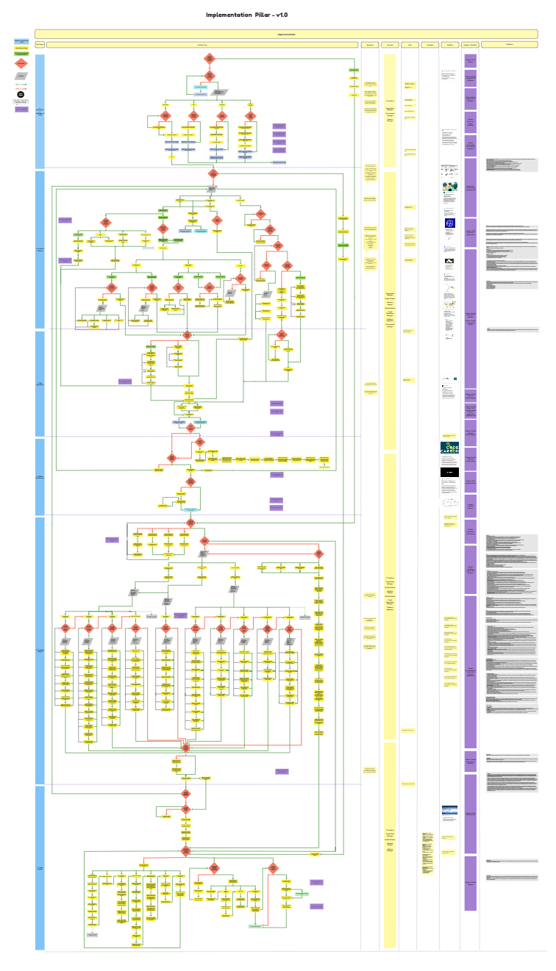
Implementation Pillar and Personas
Persona | RACI | Key Motivation | Artifacts | Data Required
Finance Manager | Consult and Informed | As a finance manager, I am overseeing the financial health and reporting of the organization, including investments in sustainable IT. | As a finance manager, I am overseeing the financial health and reporting of the organization, including investments in sustainable IT. | Financial performance metrics, Budget and expenditure data, Investment opportunity assessments, Cost-benefit analysis of green initiatives, Financial forecasts
Procurement Manager | Consult | As a procurement specialist, I am responsible for acquiring goods and services that align with our green IT initiatives. | Sustainable vendor contracts, green purchase orders, green procurement strategies. | Supplier sustainability credentials, Contract terms and conditions, Procurement policies, Cost and pricing data, Supplier performance metrics
Technology Innovator | Responsible | As a technology innovator, I am exploring and implementing new technologies to drive sustainability and competitive advantage. | Innovation roadmaps, technology assessments for sustainability, pilot project reports on green technology. | Technology trends and research, Innovation project performance metrics, Sustainability impact data, Cost-benefit analysis, Stakeholder feedback and adoption rates
Product Owner | Accountable | As a product owner, I am defining product vision and prioritizing features to deliver maximum value with sustainability in mind. | Product backlogs, user stories with sustainability features, release plans. | Market and user research, Product performance metrics, Sustainability impact assessments, Stakeholder feedback, Competitive analysis
Business Analyst | Responsible | As a business analyst, I am analyzing business needs and translating them into technical requirements with a focus on sustainability. | Business requirements documents, process flows with sustainability considerations, green use case diagrams. | Business process documentation, Requirements specifications, Stakeholder interviews and feedback, Sustainability impact data
Programme Manager | Responsible | As a programme manager, I am coordinating and overseeing multiple projects to ensure they align with our strategic sustainability objectives in IT. | Green program charters, sustainable IT project plans, green status reports. | Project timelines and milestones, Resource allocation data, Budget and financial data, Performance metrics, Risk assessments
Cloud Architect | Accountable | As a cloud architect, I am designing cloud solutions that optimize performance while minimizing environmental impact. | Cloud architecture diagrams, sustainable cloud design specifications, cloud sustainability assessments. | Cloud infrastructure requirements, performance and scalability data, sustainability impact assessments, cloud service provider capabilities, stakeholder requirements
Cloud Operations Manager | Responsible | As a cloud operations manager, I am overseeing the operations of our cloud environments to ensure they are efficient and sustainable. | Cloud operations manuals, green operations dashboards, sustainability performance reports for cloud operations. | Operations performance metrics, incident and change management records, sustainability impact data, capacity planning data, operational efficiency benchmarks
FinOps Manager | Responsible | As a FinOps manager, I am optimizing cloud financial management to achieve cost efficiency and support sustainable IT initiatives. | Cloud cost analysis report, cost optimization plans, budget forecasts for cloud expenditures, cloud cost allocations models, sustainability impact assessments of cloud usage, monthly finops performance dashboards | Cloud usage data, cost allocation data, budget forecasts, cost optimization opportunities, sustainability impact data, financial performance metrics
IT Leader | Consult and Informed | As an IT leader, I am driving the strategic direction and ensuring the operational excellence of our IT initiatives, with a focus on sustainability and innovation. | IT strategic plans, technology roadmaps, performance dashboards, IT governance policies, sustainability impact reports, risk management plans, budget and resource allocation reports. | IT performance metrics, market trends, technology assessments, budget and financial reports, risk assessments, stakeholder feedback, regulatory compliance data, innovation benchmarks
Software Engineers | Rsponsible | As a software engineer, I am responsible for creating the applications/tools and underlying processes and capture, calculate and make available metrics. | Requirements to implement the solution, RAG status, RAID log | Underlying data from applications that provide data for calculations, methodologies.

Slide 14
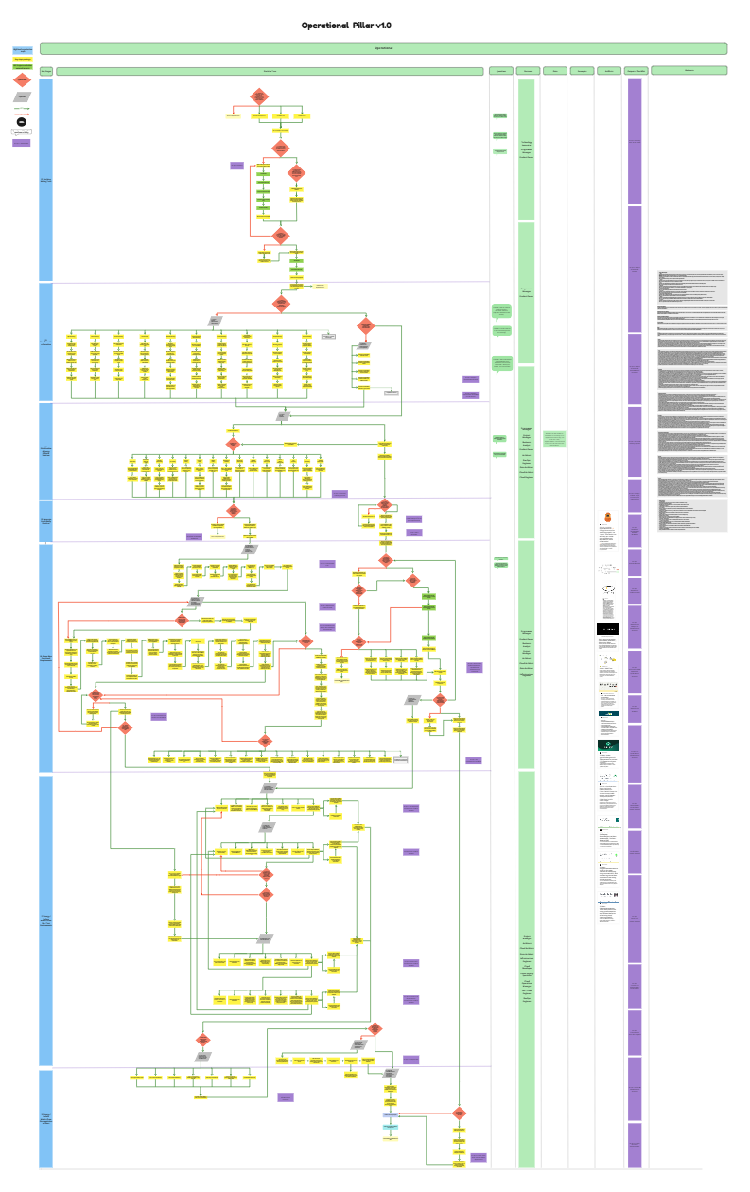
Operational Pillar and Personas
Persona | RACI | Key Motivation | Artifacts | Data Required
Procurement | Consult | As a procurement specialist, I am responsible for acquiring goods and services that align with our green IT initiatives. | Sustainable vendor contracts, green purchase orders, green procurement strategies. | Supplier sustainability credentials, Contract terms and conditions, Procurement policies, Cost and pricing data, Supplier performance metrics
Programme Manager | Responsible | As a programme manager, I am coordinating and overseeing multiple projects to ensure they align with our strategic sustainability objectives in IT. | Green program charters, sustainable IT project plans, green status reports. | Project timelines and milestones, Resource allocation data, Budget and financial data, Performance metrics, Risk assessments
Architect | Accountable | As an architect, I am designing the structural framework and ensuring the integrity of our technical solutions with sustainability in mind. | Architectural diagrams, sustainable design specifications, IT sustainability roadmaps. | System requirements and specifications, Sustainability standards and guidelines, Technology stack and infrastructure details, Performance and scalability metrics, Stakeholder requirements
Developer | Accountable | As a developer, I am creating and maintaining software applications with a focus on minimizing environmental impact. | Code repositories, development plans with sustainability criteria, user stories with green considerations. | Functional and technical requirements, Codebase and version control data, Performance benchmarks, Sustainability impact assessments, Testing and debugging data
Infrastructure Engineer | Responsible | As an infrastructure engineer, I am managing and optimizing our IT infrastructure for sustainability and performance. | Network diagrams, sustainable system configurations, green maintenance schedules. | Infrastructure performance metrics, Sustainability impact data, Configuration management data, Incident and change management records, Capacity planning data
Data Architect | Accountable | As a data architect, I am designing and managing our data architecture to ensure data integrity, accessibility, and sustainability. | Data models, sustainable database schemas, data governance policies focused on green IT. | Data requirements and specifications, Data quality metrics, Database performance data, Sustainability impact assessments, Data security and compliance records
Technology Innovator | Responsible | As a technology innovator, I am exploring and implementing new technologies to drive sustainability and competitive advantage. | Innovation roadmaps, technology assessments for sustainability, pilot project reports on green technology. | Technology trends and research, Innovation project performance metrics, Sustainability impact data, Cost-benefit analysis, Stakeholder feedback and adoption rates

Slide 15
Operational Personas (cont.)
Persona | RACI | Key Motivation | Artifacts | Data Required
Tester | Accountable | As a tester, I am ensuring the quality and functionality of our software through rigorous testing, with a focus on sustainability. | Test plans, bug reports with sustainability impact, test automation scripts for green IT. | Functional and non-functional requirements, Test case documentation, Defect tracking data, Test environment configurations, Performance and sustainability benchmarks
Product Owner | Consult | As a product owner, I am defining product vision and prioritizing features to deliver maximum value with sustainability in mind. | Product backlogs, user stories with sustainability features, release plans. | Market and user research, Product performance metrics, Sustainability impact assessments, Stakeholder feedback, Competitive analysis
Business Analyst | Consult | As a business analyst, I am analyzing business needs and translating them into technical requirements with a focus on sustainability. | Business requirements documents, process flows with sustainability considerations, green use case diagrams. | Business process documentation, Requirements specifications, Stakeholder interviews and feedback, Sustainability impact data
Project Manager | Responsible | As a project manager, I am leading project teams to deliver projects on time, within scope, and on budget, with an emphasis on sustainability. | Project plans, Gantt charts with sustainability milestones, risk management plans for green IT. | Project timelines and schedules, resource allocation data, budget and financial data, risk assessment data, performance metrics
Cloud Architect | Accountable | As a cloud architect, I am designing cloud solutions that optimize performance while minimizing environmental impact. | Cloud architecture diagrams, sustainable cloud design specifications, cloud sustainability assessments. | Cloud infrastructure requirements, performance and scalability data, sustainability impact assessments, cloud service provider capabilities, stakeholder requirements.
Cloud Engineer | Accountable | As a cloud engineer, I am implementing and managing cloud infrastructure with a focus on sustainability. | Cloud infrastructure configurations, cloud optimization reports, sustainable deployment scripts. | Cloud infrastructure performance data, deployment and configuration scripts, sustainability impact data, incident and change management records, capacity planning data.
Cloud Security Specialist | Accountable | As a cloud security specialist, I am ensuring that our cloud solutions are secure and adhere to sustainability practices. | Cloud security policies, green security assessments, compliance certifications for cloud sustainability. | Security requirements and standards, vulnerability and threat assessment data, compliance documentation, incident response plans, sustainability impact assessments.
Cloud Developer | Responsible | As a cloud developer, I am building and maintaining cloud-native applications with an emphasis on reducing their environmental footprint. | Green cloud-native code repositories, sustainable development plans, cloud-based user stories with green considerations. | Functional and technical requirements, codebase and version control data, performance benchmarks, sustainability impact assessments, testing and debugging data.
Cloud Operations Manager | Accountable | As a cloud operations manager, I am overseeing the operations of our cloud environments to ensure they are efficient and sustainable. | Cloud operations manuals, green operations dashboards, sustainability performance reports for cloud operations. | Operations performance metrics, incident and change management records, sustainability impact data, capacity planning data, operational efficiency benchmarks
FinOps Manager | Informed | As a FinOps manager, I am optimizing cloud financial management to achieve cost efficiency and support sustainable IT initiatives. | Cloud cost analysis report, cost optimization plans, budget forecasts for cloud expenditures, cloud cost allocations models, sustainability impact assessments of cloud usage, monthly finops performance dashboards. | Cloud usage data, cost allocation data, budget forecasts, cost optimization opportunities, sustainability impact data, financial performance metrics.
SRE - Cloud Engineer | Informed | As a SRE - Cloud Engineer, I am designing, building, and maintaining cloud infrastructure and services while optimizing for environmental sustainability. | Infrastructure as code files e.g. Terraform scripts, monitoring dashboards for real time performance, incident reports and root cause analysis, runbooks and playbooks, CI/CD pipeline configuration, capacity and performance reports, alerting documents against SLA's, configuration management artifacts and security and compliance audits. | Cloud resource metrics, application performance metrics, logs and traces, incident data, monitoring and alerting data, security event data, capacity and usage metrics, version control information and cost data.
DevOps Engineer | Responsible | As a DevOps Engineer, I am automating and operations, building and maintaining CI/CD pipeline management, optimizing cloud and infrastructure, sustainable resource management, monitoring and observability with Green IT metrics, | Infrastructure as code templates, CI/CD pipeline configurations, energy and environmental monitoring dashboards, Green IT best practices, automation playbooks and runbooks, incident reports and root case analyses, resource utilization and environmental impact reports, containerization configurations and Green IT compliance reports | Resource utilization data, energy consumption metrics, CO2 emission data, cloud cost and efficiency data, workload efficiency data, environmental impact of infrastructure providers, build and deployment data, application performance metrics, heat and power metrics and SLA Data.

Slide 16
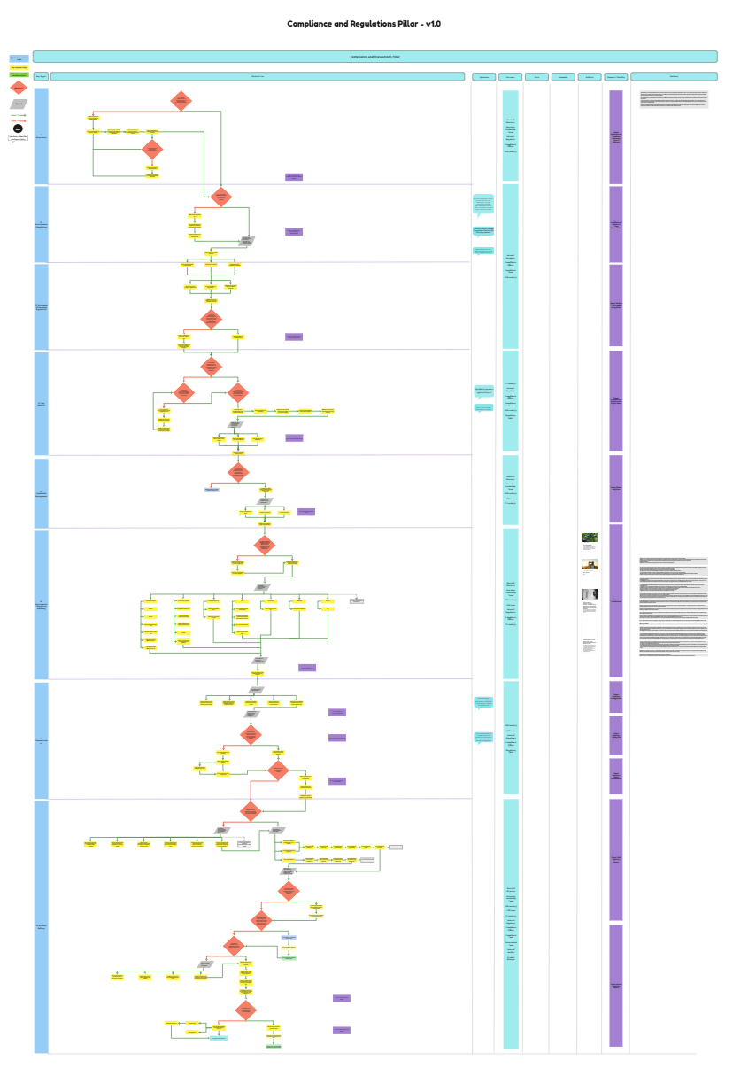
Compliance & Regulations Pillar and Personas
Persona | RACI | Key Motivation | Artifacts | Data Required
Board of Directors | Informed | As a member of the board of directors, I am responsible for overseeing the organisations regulations and that we have the policies and frameworks in place to comply. I also monitor the CEO and senior management to ensure they are implementing appropriate regulatory compliance measures. In some cases, I will interact directly with the regulators. | Board meeting agenda and minutes, governance documents, strategic and oversight documents (including risk management frameworks, compliance reports, audit reports, regulatory filings and approvals. | Strategic data, financial data, risk management data, regulatory and compliance data, ESG and sustainability data, stakeholder data, decision specific data
Executive Leadership Team (CEO, CFO, etc) | Accountable | As a member of the executive team, I manage and respond to regulations that affect the organization, which includes staying informed, leveraging expertise and trend analysis. I also have to ensure policy development, resource allocation and risk assessment. | Strategic planning, governance and policy and financial performance reporting. | Strategic decision-making, financial and operational performance, environmental data, technology data
ESG Leader | Accountable | As an ESG leader, I am ensuring that our company meets and exceeds environmental, social, and governance standards, particularly in IT. | ESG reports, IT sustainability assessments, compliance certifications for green IT. | Regulatory requirements and guidelines, Sustainability performance metrics, Environmental impact data, Stakeholder expectations and feedback, Benchmarking data against industry standards
CSR Team | Accountable | As a CSR team member, I must stay updated on the latest compliance and ensure the risks have been assessed and mitigated and that the regulations are integrated into business strategy. I must also ensure there is adequate education and training and provide proactive leadership for IT sustainable strategies. | CSR policy, environmental policy, regulatory documentation, ESG reports, training and awareness materials, certifications and declarations, legal disclosures. | Environmental data (energy consumption, carbon emissions, water usage etc), operational data, reporting and benchmarking data, risk and impact data
Internal Regulator | Consult | As an internal regulations manager, I am establishing and enforcing policies to ensure organizational compliance with sustainable IT practices. | Green policy documents, IT sustainability compliance checklists, internal green audits. | Regulatory and compliance requirements, Internal audit findings, Compliance metrics and reports, Industry best practices, Policy and procedure documentation
Investor Relations Team | Consult | As an investor relations team member, I am responsible for acting as a bridge between the company and its stakeholders, including investors, analysts and regulators. | Compliance and disclosure documents, transparency and fair disclosures, environmental disclosures. | Financial data, ESG data, environmental data, regulatory and legal data, and operational data

Slide 17
Compliance & Regulations Personas(cont.)
Persona | RACI | Key Motivation | Artifacts | Data Required
Internal Auditor | Informed | As an internal auditor, I am evaluating the effectiveness of our internal controls and risk management processes with a focus on sustainable IT. | Green audit reports, IT sustainability risk assessments, compliance reviews. | Audit criteria and standards, Risk assessment data, Compliance documentation, Historical audit reports, Process and control documentation
Compliance Team | Responsible | As an internal compliance regulator, I am ensuring the regulatory rules are adhered. | Compliance and disclosure documents, transparency and fair disclosures, environmental disclosures. | Financial data, ESG data, environmental data, regulatory and legal data, and operational data
Procurement team | Informed | As a procurement team member, I am responsible for monitoring the scope 3 emissions for the organisation. | Green audit reports, IT sustainability risk assessments, contract terms, SLAs with vendors. | Contract documentation, contract management and audit data, IT operational data, environmental data.
Compliance Officer | Responsible | As a compliance officer, I am ensuring that our company adheres to all relevant laws and regulations regarding sustainable IT. | Green compliance manuals, regulatory filings for IT sustainability, training materials on green practices. | Current regulatory requirements, Compliance program details, Training attendance and completion records, Compliance incident reports, Industry compliance benchmarks
Product Manager | Responsible | As a product manager, I am responsible for managing the product life-cycle and ensuring that they are inline with the IT Sustainability Strategy, | Product plans, requirement lists, IT sustainability strategy, business plans. | Product data, project data, IT operational data, costs, timeline data, testing data and customer feedback data.
Finance | Responsible | As a finance manager, I am overseeing the financial health and reporting of the organization, including investments in sustainable IT. | As a finance manager, I am overseeing the financial health and reporting of the organization, including investments in sustainable IT. | Financial performance metrics, Budget and expenditure data, Investment opportunity assessments, Cost-benefit analysis of green initiatives, Financial forecasts
IT Leader | Responsible | As an IT leader, I am driving the strategic direction and ensuring the operational excellence of our IT initiatives, with a focus on sustainability and innovation. | IT strategic plans, technology roadmaps, performance dashboards, IT governance policies, sustainability impact reports, risk management plans, budget and resource allocation reports. | IT performance metrics, market trends, technology assessments, budget and financial reports, risk assessments, stakeholder feedback, regulatory compliance data, innovation benchmarks
Regulatory SMEs | Responsible | As a regulatory SME, I am responsible for ensuring that regulations are assessed, and gaps are identified for the IT organization. | Regulations, disclosures, IT plans, IT operational documentation, environmental documentation. | Regulatory data, risks, timelines, IT operational data.

